Slide 1


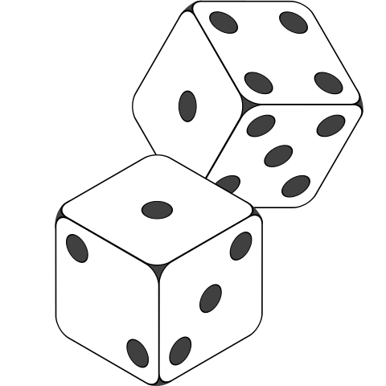



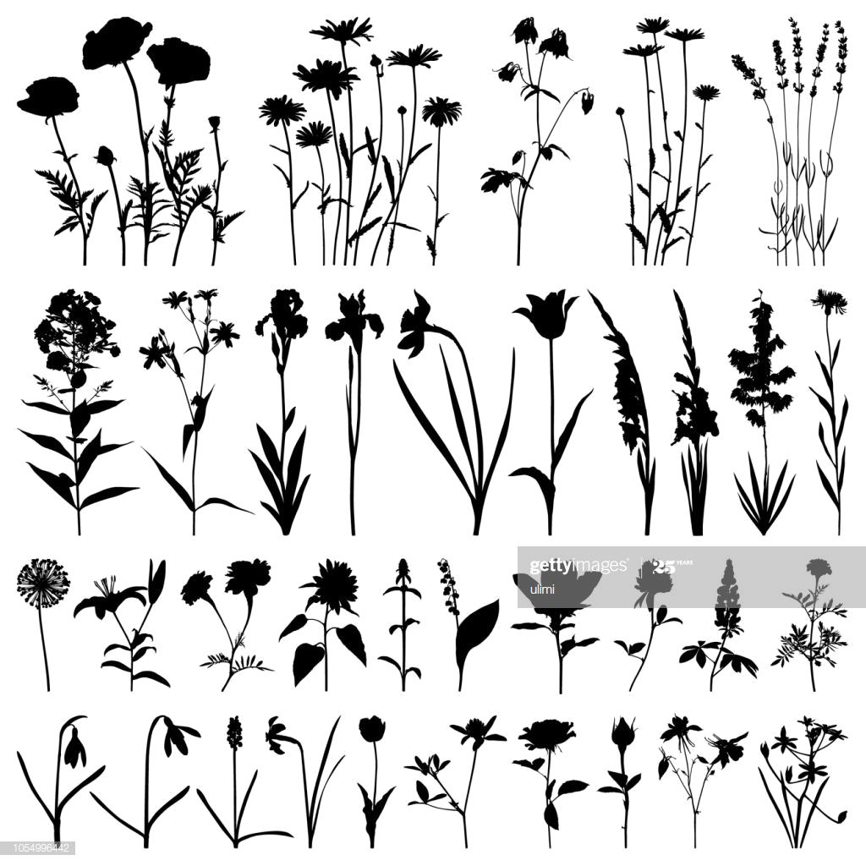




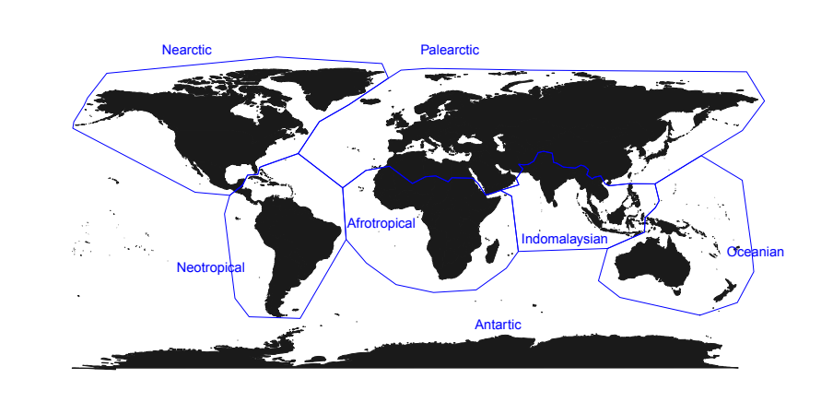














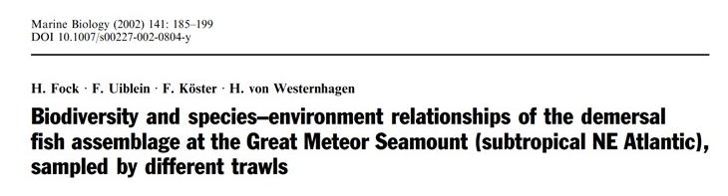


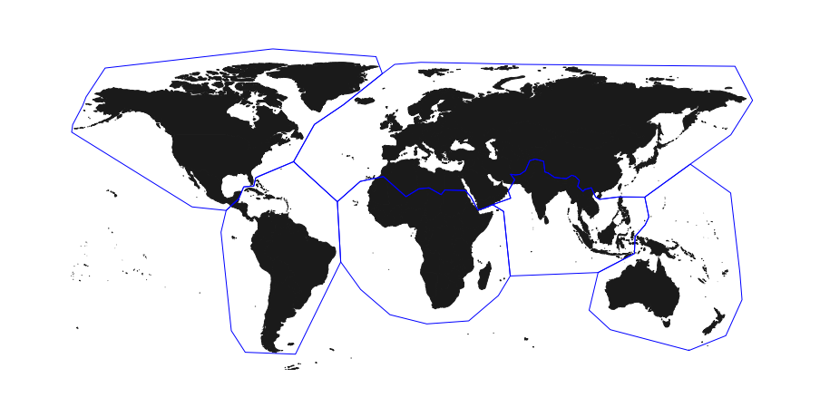
A
Literature extraction
Random selection (~10%)
TI = “Biodiversity” AND PY = 1986–2020 AND WC = ("Ecology" OR "Soil Science" OR "Environmental Studies" OR "Environmental Sciences" OR "Marine & Freshwater Biology" OR "Multidisciplinary Sciences" OR "Paleontology")
N = 10170 articles
N = 916 articles
N = 65 not found
B
Propotion of biodiversity
Biodiversity facets
Methods
Geography & System
Title “descriptors”
Observed biodiversity
29 cm
Method(s) to collect biodiversity data
Biogeographic region(s) and system(s)
Mention of Habitat, Taxa,
or Locations in the title
e.g., 4 out of 56 = 0.07
Insectivorous
Expected biodiversity
(N = 56 macrogroups)
C
What proportion of biodiversity is sampled by studies, and across what facets?
How does the proportion of sampled biodiversity varies across systems, regions and over time?
Is a low proportion of sampled biodiversity compensated by the use
of descriptors in the title?
Is there a relationship between the proportion of sampled biodiversity, the use of descriptors, and impact?
Biodiversity
Biodiversity
Biodiversity
Publication year
Location
No descriptors
Habitat
Taxa
Impact
(e.g. citation)

